Slide 1
Introduction to Jetpack Compose
By Nisar Ahmed Siddiqui

Slide 2
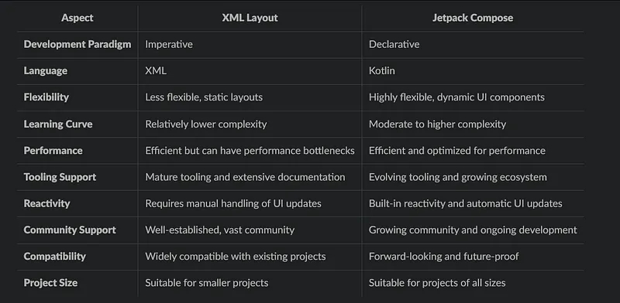
JetPack Compose vs XML Views
Notes:
Key Differences and Benefits
Now, let’s dive into the distinctive features and approaches to help you make an informed choice:
Development Paradigm: The first consideration is the development style. XML Layout follows an imperative paradigm, while Jetpack Compose adopts a declarative approach. Consider your team’s preferred development style and your project’s specific needs when deciding.
Language: Another crucial factor is the choice of programming language. XML relies on its markup language, while Jetpack Compose uses Kotlin. Assessing your team’s proficiency with these languages is essential, as it can significantly impact development speed and code quality.
Flexibility: Consider the flexibility of your UI requirements. XML Layout can be less flexible, particularly with static layouts. In contrast, Jetpack Compose empowers you to create dynamic UI components. Your decision should align with the complexity of your UI and its adaptability needs.
Learning Curve: Next, think about the learning curve. XML Layout tends to have a shallower curve due to its extensive documentation and long-standing history. On the other hand, Jetpack Compose introduces a moderate to high learning curve, primarily because of its novel paradigm. Assess your team’s readiness for this learning journey.
Performance: Regarding performance, XML Layout can be efficient, but it may encounter bottlenecks, especially with complex UIs. Jetpack Compose, designed with performance in mind, offers automatic UI updates and optimizations, ensuring smoother user experiences.
Tooling Support: Evaluate the tooling support. XML Layout benefits from mature tools and a wealth of documentation. Jetpack Compose, while promising, is still evolving its tooling and expanding its ecosystem. Consider your team’s familiarity with the available tools.
Reactivity: Think about how reactivity is handled. XML Layout typically requires manual updates to the user interface. In contrast, Jetpack Compose incorporates built-in reactivity, simplifying UI updates and interactions.
Community Support: Consider the strength of the developer community. XML Layout boasts a well-established and extensive community. Meanwhile, Jetpack Compose’s community is growing steadily. The availability of resources and community support can influence your choice.
Compatibility: Assess compatibility with your existing projects. XML Layout seamlessly integrates with legacy applications. In contrast, Jetpack Compose may necessitate adjustments to fit into the context of older apps. Think about the compatibility requirements of your project.
Project Size: Finally, project size matters. XML Layout is well-suited for more minor projects due to its simplicity. With its flexibility and robust capabilities, Jetpack Compose shines in projects of all sizes, particularly complex ones. Consider the scale and complexity of your project when making your decision.

Slide 3
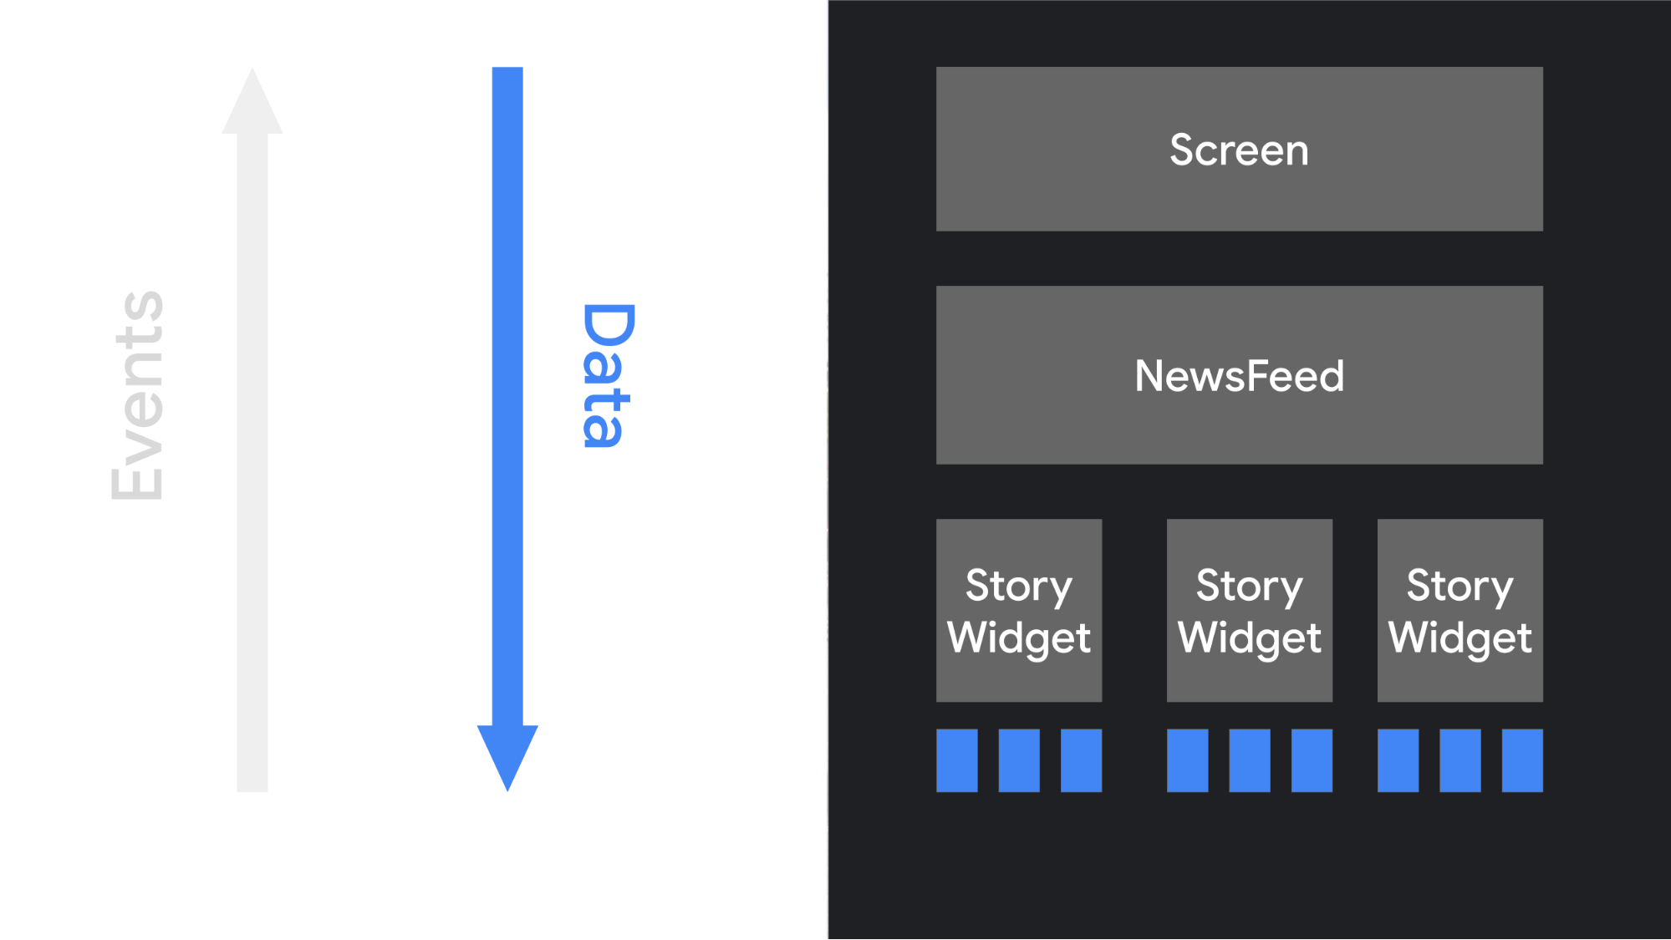
Declarative Paradigm Shift
With many imperative object-oriented UI toolkits, we initialize the UI by instantiating a tree of widgets. We often do this by inflating an XML layout file. Each widget maintains its own internal state, and exposes getter and setter methods that allow the app logic to interact with the widget.
In Compose's declarative approach, widgets are relatively stateless and do not expose setter or getter functions. In fact, widgets are not exposed as objects. You update the UI by calling the same composable function with different arguments. This makes it easy to provide state to architectural patterns such as a ViewModel. Then, our composables are responsible for transforming the current application state into a UI every time the observable data updates.

Slide 4
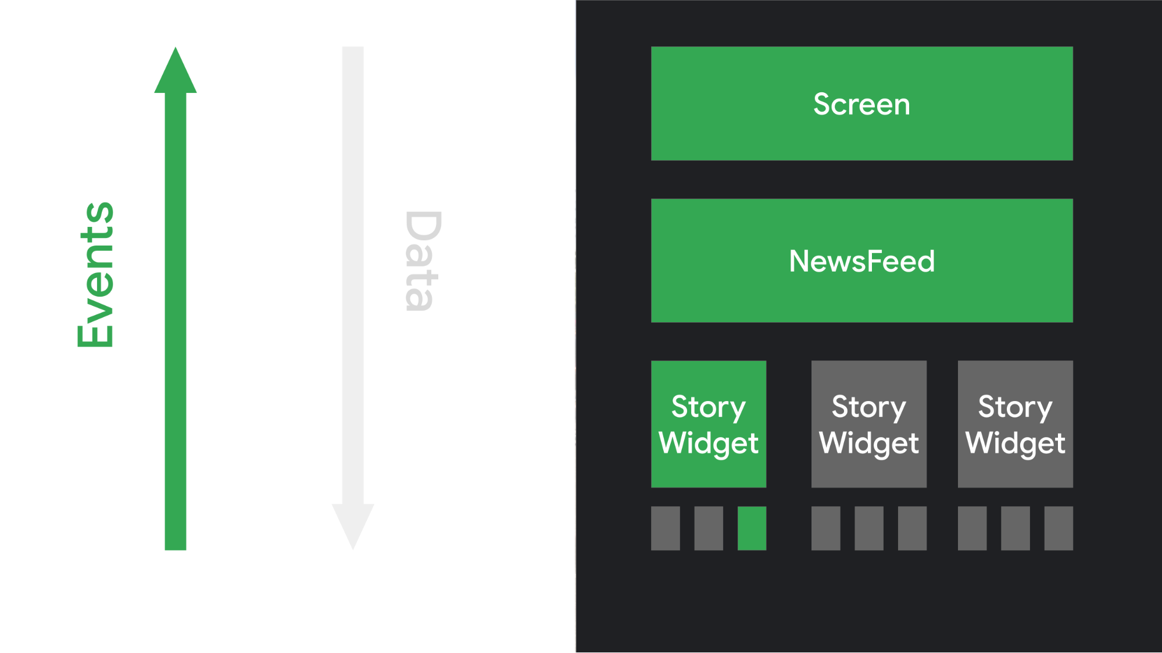
Declarative Paradigm Shift - Continued
When the user interacts with the UI, the UI raises events such as onClick. Those events should notify the app logic, which can then change the app's state. When the state changes, the composable functions are called again with the new data. This causes the UI elements to be redrawn--this process is called recomposition.

Slide 5
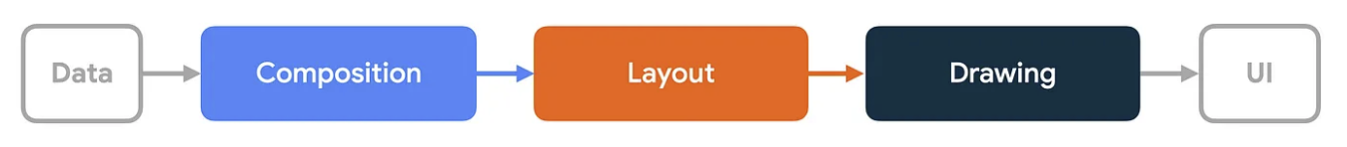
The three phases of a frame
Compose has three main phases:
Composition: What UI to show. Compose runs composable functions and creates a description of your UI.
Layout: Where to place UI. This phase consists of two steps: measurement and placement. Layout elements measure and place themselves and any child elements in 2D coordinates, for each node in the layout tree.
Drawing: How it renders. UI elements draw into a Canvas, usually a device screen.

Slide 6
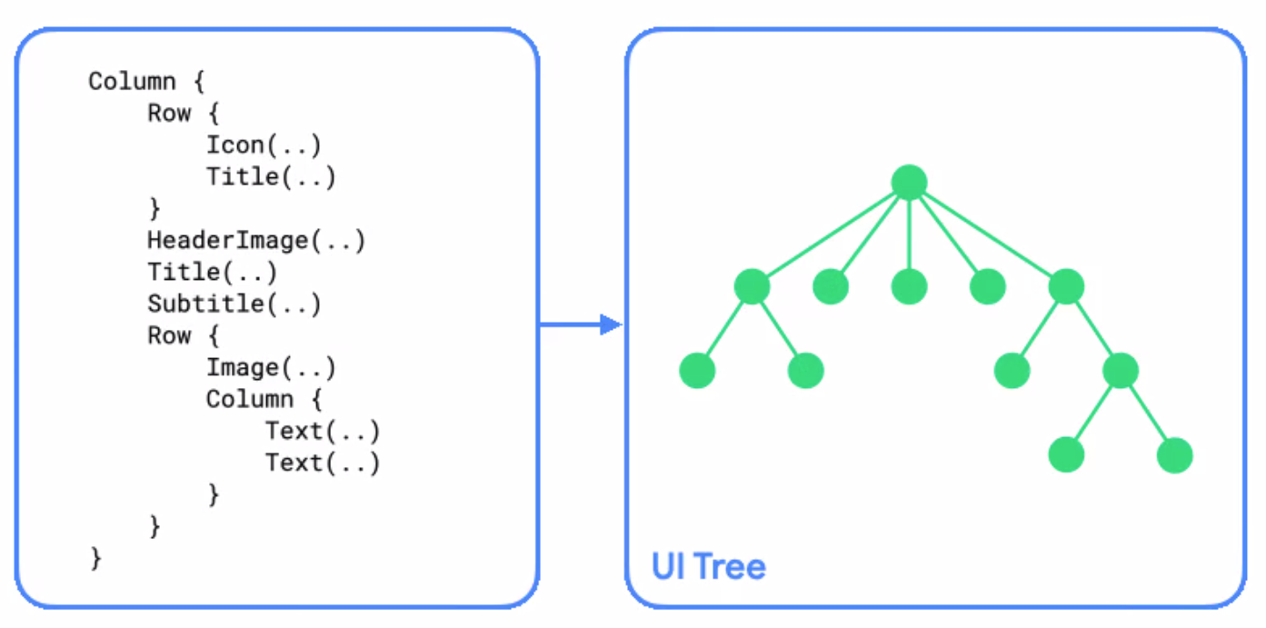
1. Composition
In the composition phase, the Compose runtime executes composable functions and outputs a tree structure that represents your UI. This UI tree consists of layout nodes that contain all the information needed for the next phases.

Slide 7
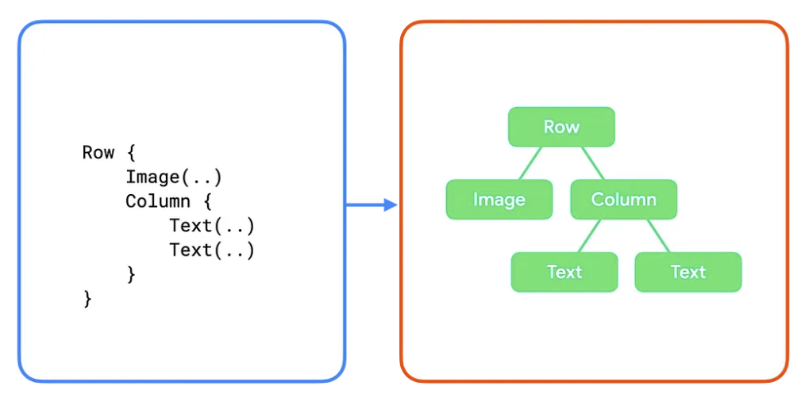
1. Composition - Continued
A subsection looks like this:

Slide 8
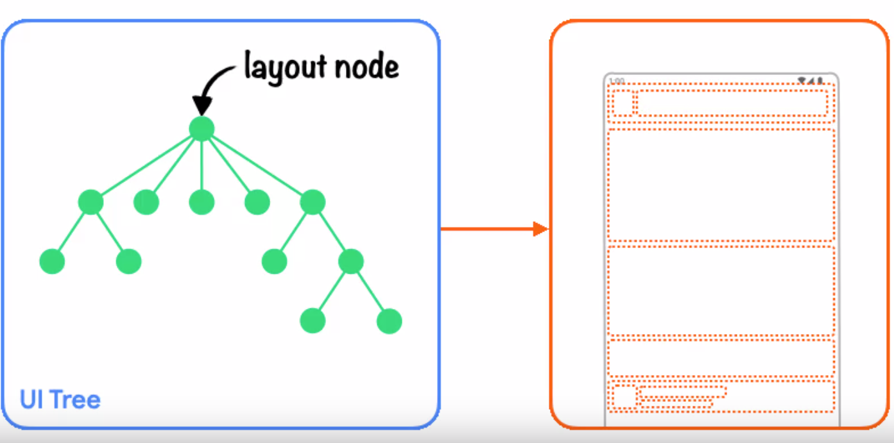
2. Layout
In the layout phase, Compose uses the UI tree produced in the composition phase as input. The collection of layout nodes contain all the information needed to decide on each node's size and location in 2D space.
Notes:
During the layout phase, the tree is traversed using the following three step algorithm:
Measure children: A node measures its children if any exist.
Decide own size: Based on these measurements, a node decides on its own size.
Place children: Each child node is placed relative to a node's own position.
At the end of this phase, each layout node has:
An assigned width and height
An x, y coordinate where it should be drawn

Slide 9
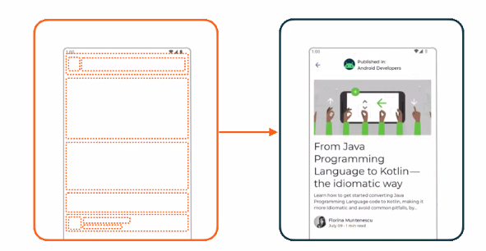
3. Drawing
In the drawing phase, the tree is traversed again from top to bottom, and each node draws itself on the screen in turn.
Notes:
Using the previous example, the tree content is drawn in the following way:
The Row draws any content it might have, such as a background color.
The Image draws itself.
The Column draws itself.
The first and second Text draw themselves, respectively

Slide 10
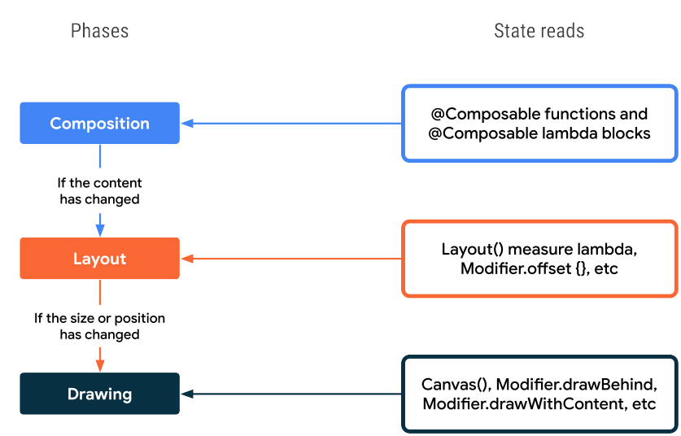
Phases During State change

Slide 11
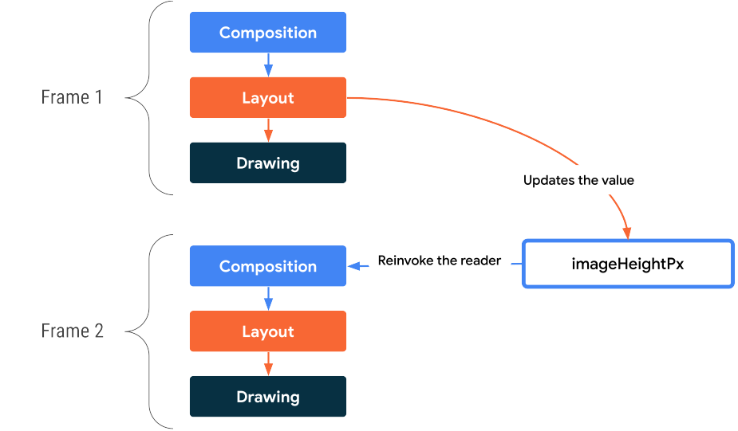
Optimized State Changes

Slide 12
Lesson 1 – Basic Components

Slide 13
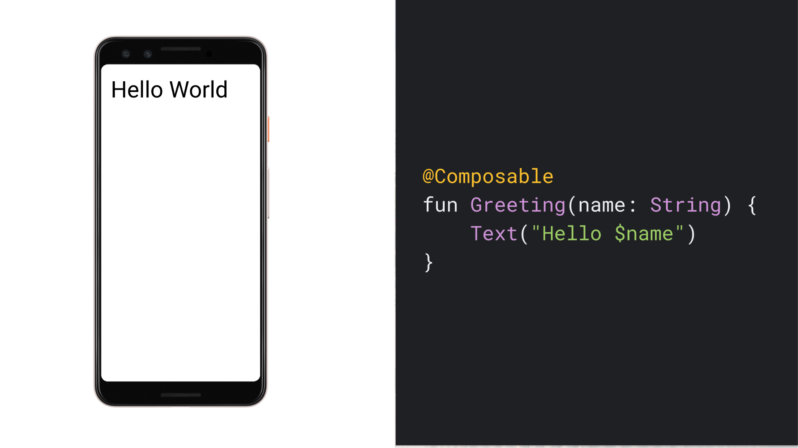
Lesson 1 - Jetpack Compose Basics
Jetpack Compose is built around composable functions
Using Compose, we can build your user interface by defining a set of composable functions that take in data and emit UI elements. A simple example is a Greeting widget, which takes in a String and emits a Text widget which displays a greeting message.
Notes:
A few noteworthy things about this function:
The function is annotated with the @Composable annotation. All Composable functions must have this annotation; this annotation informs the Compose compiler that this function is intended to convert data into UI.
The function takes in data. Composable functions can accept parameters, which allow the app logic to describe the UI. In this case, our widget accepts a String so it can greet the user by name.
The function displays text in the UI. It does so by calling the Text() composable function, which actually creates the text UI element. Composable functions emit UI hierarchy by calling other composable functions.
The function doesn't return anything. Compose functions that emit UI do not need to return anything, because they describe the desired screen state instead of constructing UI widgets.
This function is fast, idempotent, and free of side-effects.
The function behaves the same way when called multiple times with the same argument, and it does not use other values such as global variables or calls to random().
The function describes the UI without any side-effects, such as modifying properties or global variables.
In general, all composable functions should be written with these properties, for reasons discussed in Recomposition.

Slide 14
Define a composable function
// ...
import androidx.compose.runtime.Composable
class MainActivity : ComponentActivity() {
override fun onCreate(savedInstanceState: Bundle?) {
super.onCreate(savedInstanceState)
setContent {
MessageCard("Android")
}
}
}
@Composable
fun MessageCard(name: String) {
Text(text = "Hello $name!")
}
To make a function composable, add the @Composable annotation. To try this out, define a MessageCard function which is passed a name, and uses it to configure the text element.

Slide 15
Preview your function in Android Studio
The @Preview annotation lets you preview your composable functions within Android Studio without having to build and install the app to an Android device or emulator.
import androidx.compose.ui.tooling.preview.Preview
@Composable
fun MessageCard(name: String) {
Text(text = "Hello $name!")
}
@Preview
@Composable
fun PreviewMessageCard() {
MessageCard("Android")
}

Slide 16
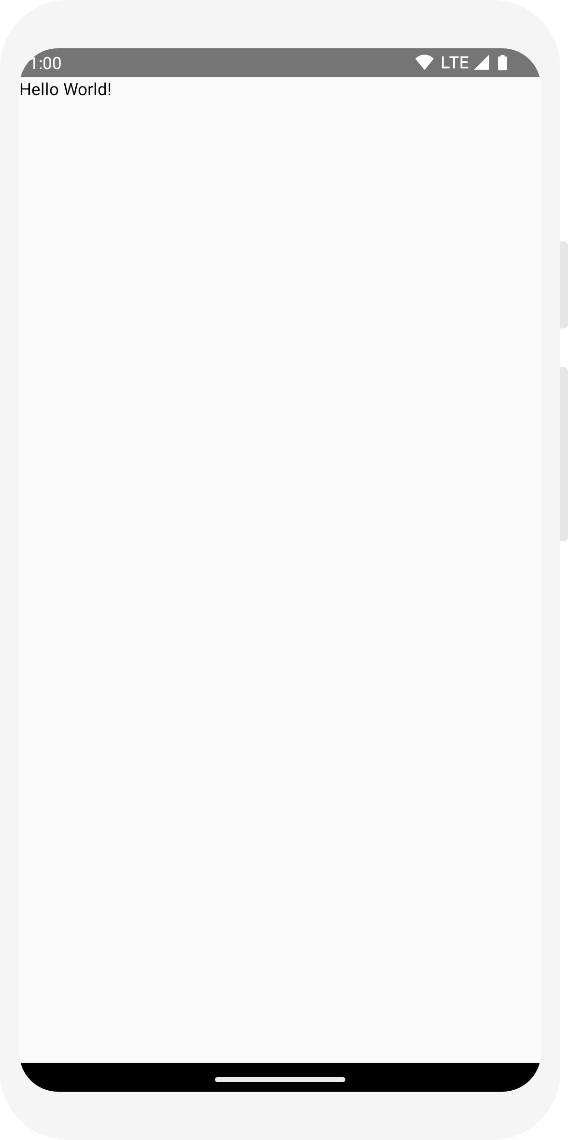
Add a text element
Display a “Hello world!” text by adding a text element inside the onCreate method
import android.os.Bundle
import androidx.activity.ComponentActivity
import androidx.activity.compose.setContent
import androidx.compose.material3.Text
class MainActivity : ComponentActivity() {
override fun onCreate(savedInstanceState: Bundle?) {
super.onCreate(savedInstanceState)
setContent {
Text("Hello world!")
}
}
}

Slide 17
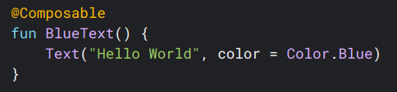
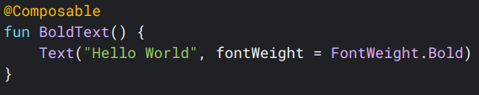
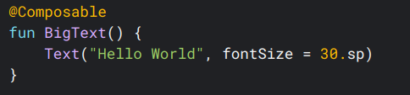
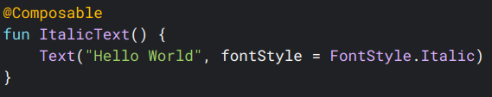
Style Text
The Text composable has multiple optional parameters to style its content. Below, we’ve listed parameters that cover the most common use cases with text. For all the parameters of Text, see the Compose Text source code.

Slide 18
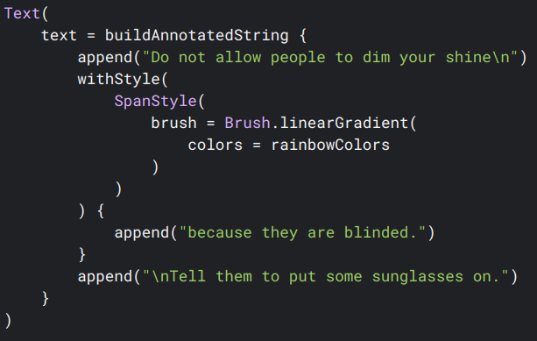
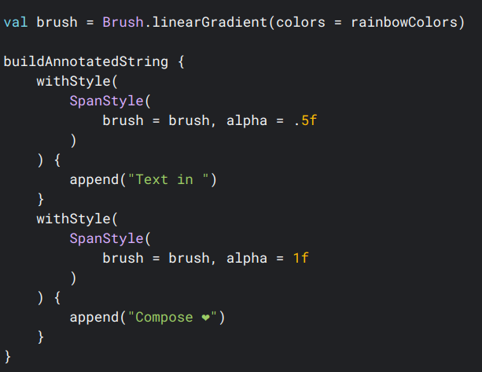
Add multiple styles

Slide 19
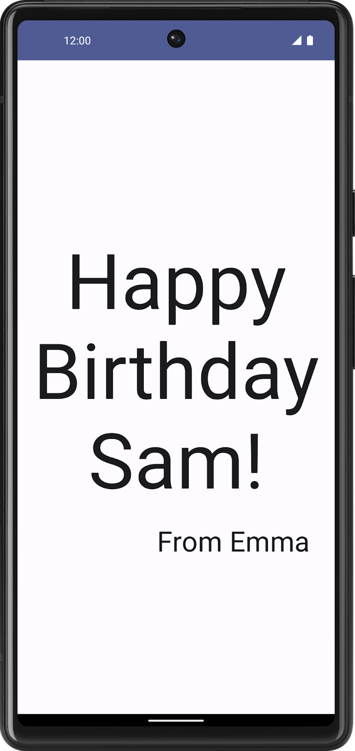
Task – Text Widget

Slide 20
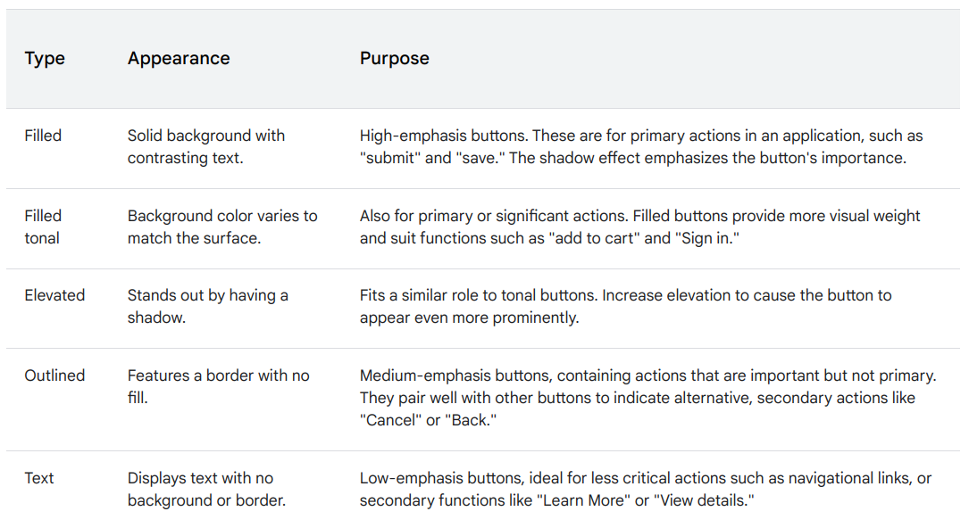
Buttons
Buttons are fundamental components that allow the user to trigger a defined action. There are five types of buttons. The following table describes the appearance of each of the five button types, as well as where you should use them.

Slide 21
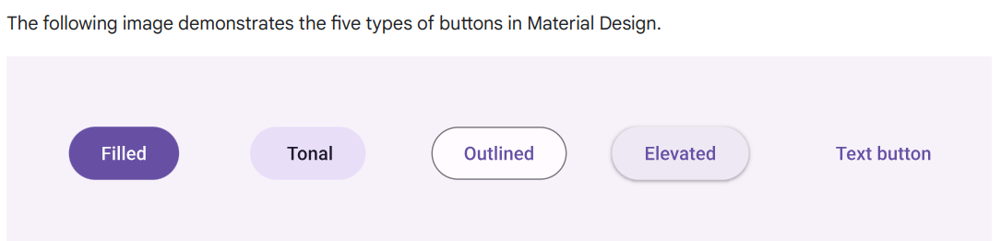
Buttons – Contd...
API surface
onClick: The function called when the user presses the button.
enabled: When false, this parameter causes the button to appear unavailable and inactive.
colors: An instance of ButtonColors that determines the colors used in the button.
contentPadding: The padding within the button.

Slide 22
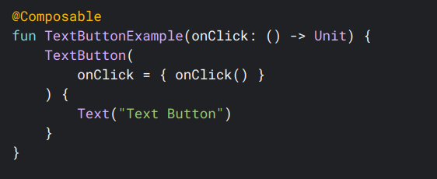
Adding a Button
The following snippet demonstrates how to implement the button component:

Slide 23
ImageBitmap vs ImageVector
A raster graphic format contains pixels: tiny individual squares that contain a color (made up of red, green, blue, and alpha values). When placing a lot of pixels together, a very detailed image can be formed, such as a photograph. A raster graphic has a fixed resolution (fixed number of pixels). This means that when you increase the size of the image, it loses detail, and pixelation can occur. Examples of raster graphic formats are JPEG, PNG, and WEBP.
Vector images, on the other hand, are scalable mathematical representations of a visual element on screen. A vector is a set of commands describing how to draw the image on screen- for instance, a line, point, or fill. When scaling a vector on screen, it will not lose quality as the mathematical formula will maintain the relationship between the different commands. A good example of ImageVector are the Material Symbols, as they can all be defined with mathematical formulas.
For simple use cases, the same way in which painterResource() works for the ImageBitmap class, it also works for ImageVectors, returning a VectorPainter as the result. painterResource() handles the loading of VectorDrawables and BitmapDrawables into VectorPainter and BitmapPainter respectively. To load a VectorDrawable into an image, use:

Slide 24
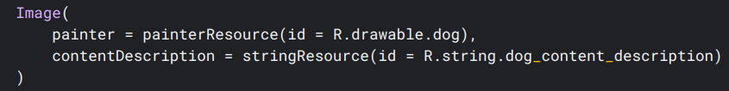
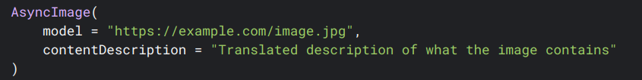
Images
Load an image from the disk using painterResource:
Load an image from the internet

Slide 25
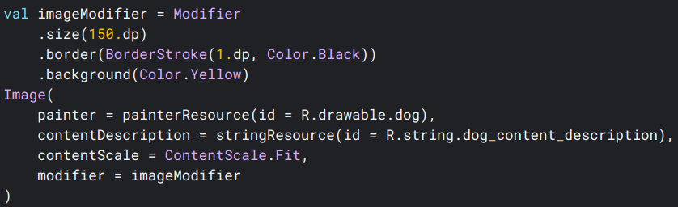
Customize Images - Link
Images can be customized using properties on an Image composable (contentScale, colorFilter). You can also apply the existing Modifiers to apply different effects to your Image. Modifiers can be used on any Composable, not just the Image composable, whereas contentScale and colorFilter are explicit parameters on the Image composable.
Content scale
Specify a contentScale option to crop or change how an image is scaled inside its bounds. By default, if you don't specify a contentScale option, ContentScale.Fit will be used.

Slide 26
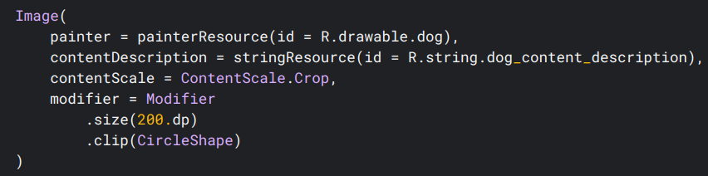

Clip an Image to a shape
To make an image fit into a shape, use the built-in clip modifier. To crop an image into a circle shape, use Modifier.clip(CircleShape):

Slide 27

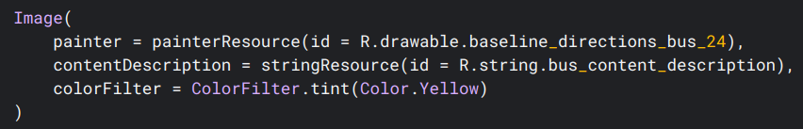
Color filter - Transform pixel colors of image
The Image composable has a colorFilter parameter that can change the output of individual pixels of your image.
Tinting an image
Using ColorFilter.tint(color, blendMode) will apply a blend mode with the given color onto your Image composable. ColorFilter.tint(color, blendMode) uses BlendMode.SrcIn to tint content, meaning that the color supplied will be shown, where the image is displayed on screen. This is useful for icons and vectors that need to be themed differently.

Slide 28
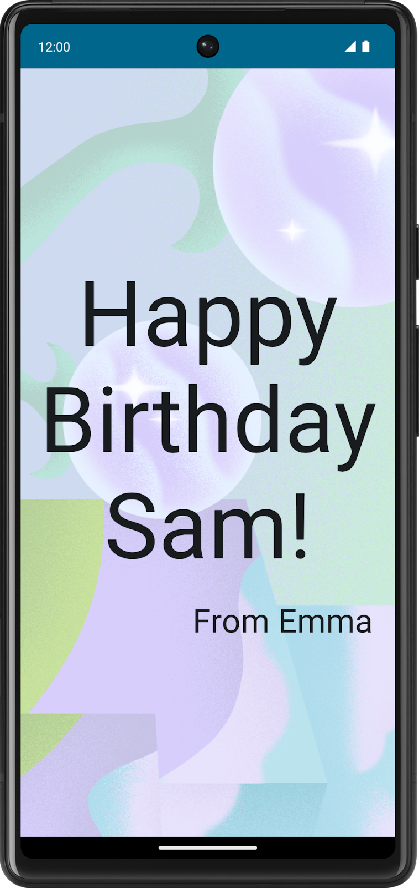
Task 2 - Images

Slide 29
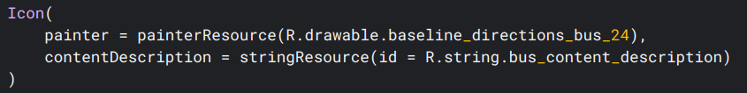
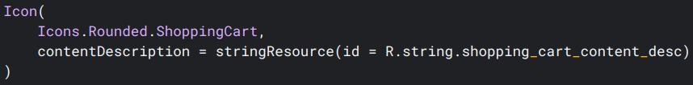
Material Icons
The Icon composable is a convenient way to draw a single color icon on screen that follows Material Design guidelines.
The Material Icon library also includes a set of predefined Icons that can be used in Compose without needing to import an SVG manually

Slide 30
Lesson 2 - Layouts

Slide 31
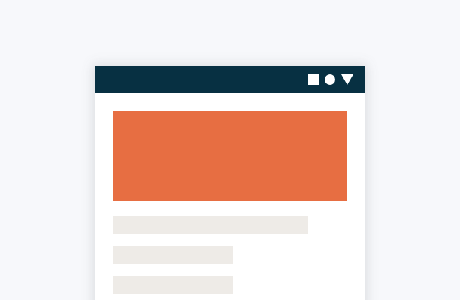
Lesson 2: Layouts
UI elements are hierarchical, with elements contained in other elements. In Compose, you build a UI hierarchy by calling composable functions from other composable functions.

Slide 32
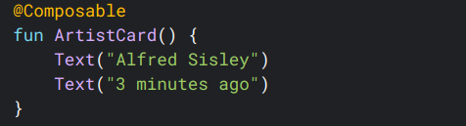

Composable functions are the basic building block of Compose.
A composable function is a function emitting Unit that describes some part of your UI.
The function takes some input and generates what's shown on the screen
Without guidance on how you want them arranged, Compose stacks the text elements on top of each other, making them unreadable:

Slide 33
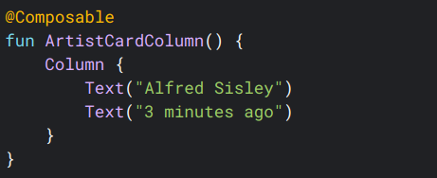

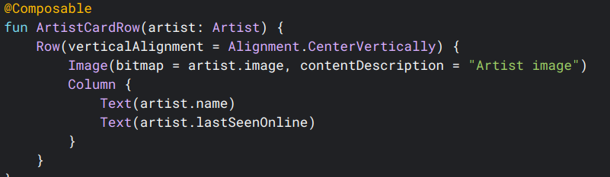

Standard layout components - Link
Use Column to place items vertically on the screen
Use Row to place items horizontally on the screen

Slide 34
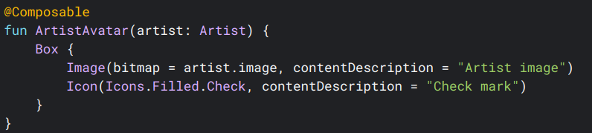
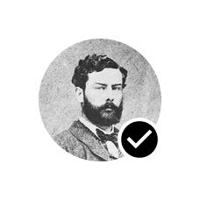
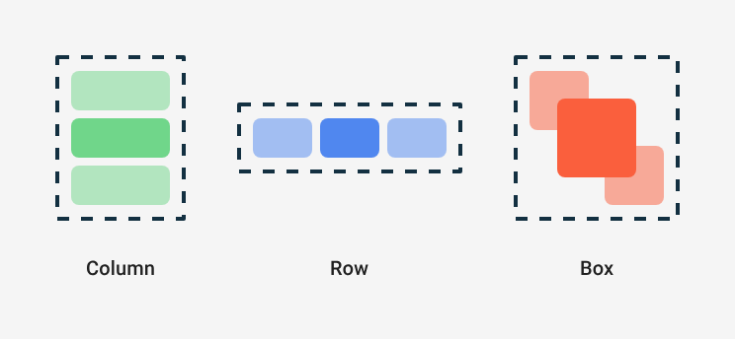
Standard layout components - Link
Use Box to put elements on top of another
Often these building blocks are all we need. We can write your own composable function to combine these layouts into a more elaborate layout that suits your app.

Slide 35
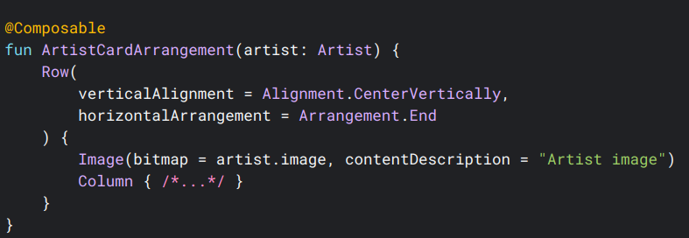

Alignment inside Row or Column
To set children's position within a Row, set the horizontalArrangement and verticalAlignment arguments. For a Column, set the verticalArrangement and horizontalAlignment arguments:

Slide 36
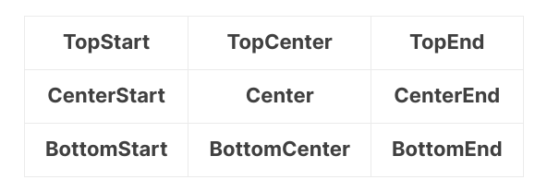
Alignment
There are nine alignment options that can be applied to child UI elements:

Slide 37
Arrangement
Horizontal | Vertical
Start | Top
End | Bottom
Center | Center
SpaceEvenly | SpaceEvenly
SpaceAround | SpaceAround
SpaceBetween | SpaceBetween
Arrangement is used to specify the arrangement of child elements in "Column" and "Row" layouts in the axis direction (horizontal and vertical).
We have a set of predefined values for horizontal and vertical arrangements:

Slide 38
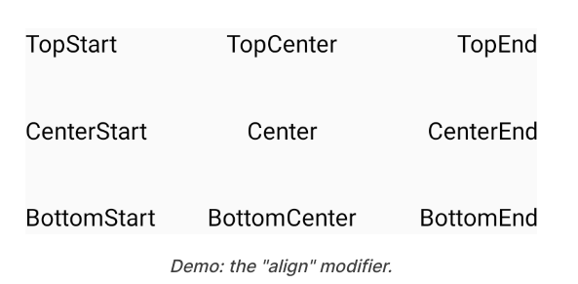
The "align" modifier
The align modifier allows us to set arrangement of children inside the Box Scope.
Box(
modifier = Modifier.size(height = 120.dp, width = 300.dp)
) {
Text(text = "TopStart", modifier = Modifier.align(Alignment.TopStart))
Text(text = "TopCenter", modifier = Modifier.align(Alignment.TopCenter))
Text(text = "TopEnd", modifier = Modifier.align(Alignment.TopEnd))
Text(text = "CenterStart", modifier = Modifier.align(Alignment.CenterStart))
Text(text = "Center", modifier = Modifier.align(Alignment.Center))
Text(text = "CenterEnd", modifier = Modifier.align(Alignment.CenterEnd))
Text(text = "BottomStart", modifier = Modifier.align(Alignment.BottomStart))
Text(text = "BottomCenter", modifier = Modifier.align(Alignment.BottomCenter))
Text(text = "BottomEnd", modifier = Modifier.align(Alignment.BottomEnd))
}

Slide 39
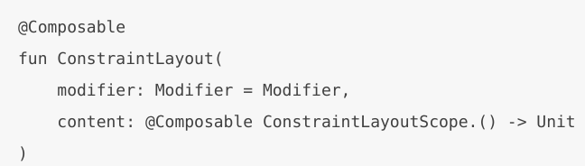
The "ConstraintLayout" layout
The "ConstraintLayout" layout positions children according to the constraints between them. It's similar to the available "ConstraintLayout" for Android development
ConstraintLayout in Compose works in the following way using a DSL:
Create references for each composable in the ConstraintLayout using the createRefs() or createRefFor()
Constraints are provided using the constrainAs() modifier, which takes the reference as a parameter and lets you specify its constraints in the body lambda.
Constraints are specified using linkTo() or other helpful methods.
parent is an existing reference that can be used to specify constraints towards the ConstraintLayout composable itself.

Slide 40
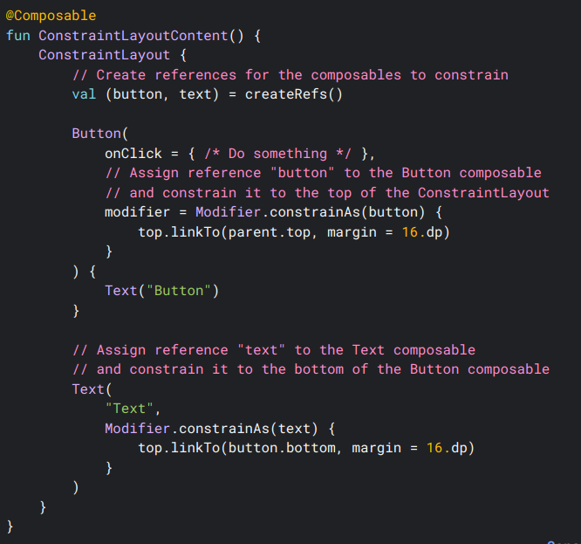
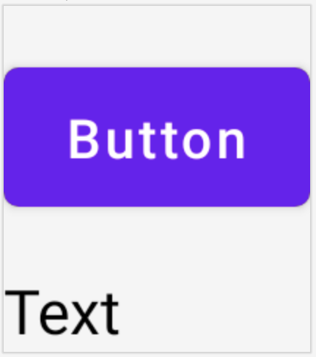
Example

Slide 41
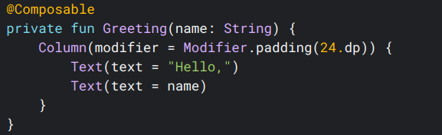
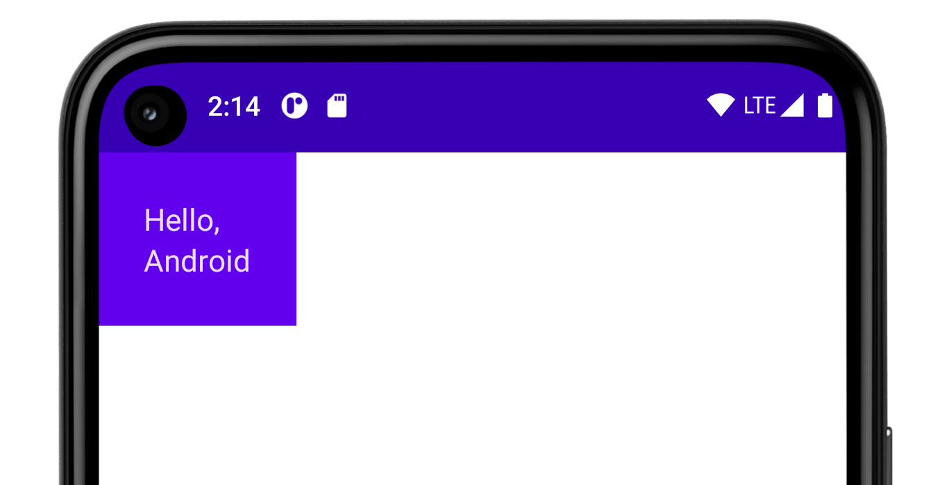
Compose Modifiers
Modifiers allow you to decorate or augment a composable. Modifiers let you do these sorts of things:
Change the composable's size, layout, behavior, and appearance
Add information, like accessibility labels
Process user input
Add high-level interactions, like making an element clickable, scrollable, draggable, or zoomable

Slide 42
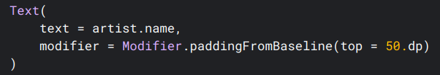
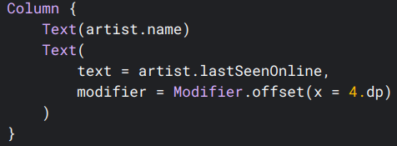
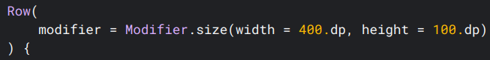
Built-in Modifiers
Jetpack Compose provides a list of built-in modifiers to help you decorate or augment a composable. Here are some common modifiers you'll use to adjust your layouts.
padding and size
Offset

Slide 43
Lesson 3 – Important Composables

Slide 44
Lesson 3 – Important Composables
Surface
Scaffold
AppBar (topBar / bottomBar)
Floating Action Buttons
Card
Chip
Dialog
SnackBar

Slide 45
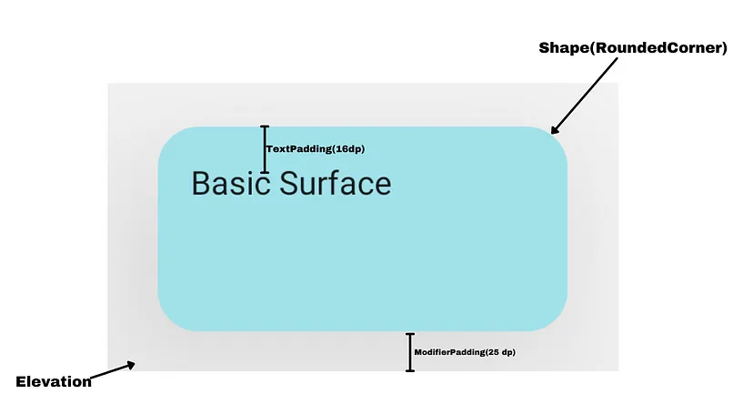
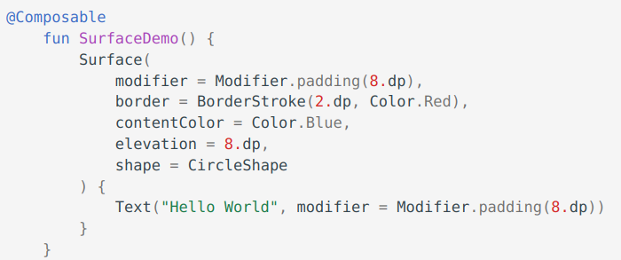
Surface
Surface is a basic building block for displaying content and can be used to wrap other composable to provide a background color, elevation, padding, and other layout properties.
Notes:
Parameters In Surface
Here are all the parameters that can be used with the Surface composable in Jetpack Compose:
modifier: Modifier to apply to the surface
color: Background color of the surface
elevation: Elevation of the surface, which adds a shadow effect
shape: Shapes of the surface, such as a rounded rectangle or a cut-corner rectangle
border: Border around the surface
contentColor: Foreground color of the surface’s content
onClick: Click listener for the surface
enabled: Whether the surface is enabled or disabled
interactionSource: Interaction source for the surface
indication: Indication to show when the surface interacted with
semantics: Accessibility properties for the surface
content: The content of the surface, specified as a composable function.

Slide 46

Scaffold
In Material Design, a scaffold is a fundamental structure that provides a standardized platform for complex user interfaces. It holds together different parts of the UI, such as app bars and floating action buttons, giving apps a coherent look and feel.
The Scaffold composable provides a straightforward API you can use to quickly assemble your app's structure according to Material Design guidelines. Scaffold accepts several composables as parameters. Among these are the following:
topBar: The app bar across the top of the screen.
bottomBar: The app bar across the bottom of the screen.
floatingActionButton: A button that hovers over the bottom-right corner of the screen that you can use to expose key actions.

Slide 47


Scaffold

Slide 48


App bars

Slide 49

App Bar

Slide 50
API surface
The various composables that allow you to implement the four different top app bars are quite similar. They share several key parameters:
title: The text that appears across the app bar.
navigationIcon: The primary icon for navigation. Appears on the left of the app bar.
actions: Icons that provide the user access to key actions. They appear on the right of the app bar.
scrollBehavior: Determines how the top app bar responds to scrolling of the scaffold's inner content.
colors: Determines how the app bar appears.

Slide 51


Code

Slide 52


Centered – App Bar

Slide 53

Floating action button
A Floating Action Button (FAB) is a high-emphasis button that lets the user perform a primary action in an application. It promotes a single, focused action that is the most common pathway a user might take and is typically found anchored to the bottom right of the screen.
In Material Design, there are four types of FAB:
FAB: A floating action button of ordinary size.
Small FAB: A smaller floating action button.
Large FAB: A larger floating action button.
Extended FAB: A floating action button that contains more than just an icon

Slide 54

Floating Action Button – Api Interface
Although there are several composables we can use to create floating action buttons consistent with Material Design, their parameters don't differ greatly. Among the key parameters are the following:
onClick: The function called when the user presses the button.
containerColor: The color of the button.
contentColor: The color of the icon.

Slide 55

Card
The Card composable acts as a Material Design container for your UI. Cards typically present a single coherent piece of content. The following are some examples of where you might use a card:
A product in a shopping app.
A news story in a news app.
A message in a communications app.

Slide 56

Card - Continued
Some key parameters to note are the following:
elevation: Adds a shadow to the component that makes it appear elevated above the background.
colors: Uses the CardColors type to set the default color of both the container and any children.
enabled: If you pass false for this parameter, the card appears as disabled and does not respond to user input.
onClick: Ordinarily, a Card does not accept click events. As such, the primary overload you would like to note is that which defines an onClick parameter. You should use this overload if you would like your implementation of Card to respond to presses from the user.

Slide 57


Card – Filled Example

Slide 58


Card - Elevated

Slide 59

Chip
The Chip component is a compact, interactive UI element. It represents complex entities like a contact or tag, often with an icon and label. It can be checkable, dismissible, or clickable.
The four types of chips and where you might use them are as follows:
Assist: Guides the user during a task. Often appears as a temporary UI element in response to user input.
Filter: Allows users to refine content from a set of options. They can be selected or deselected, and may include a checkmark icon when selected.
Input: Represents user-provided information, such as selections in a menu. They can contain an icon and text, and provide an 'X' for removal.
Suggestion: Provides recommendations to the user based on their recent activity or input. Typically appear beneath an input field to prompt user actions.

Slide 60


Chip – Api Interface
There are four composables that correspond to the four types of chips. The following sections outline these composables and their differences in detail. However, they share the following parameters:
label: The string that appears on the chip.
icon: The icon displayed at the start of the chip. Some of the specific composables have a separate leadingIcon and trailingIcon parameter.
onClick: The lambda that the chip calls when the user presses it.

Slide 61




Canvas

Slide 62

Task - 3

Slide 63

Dialogs
The Dialog component displays pop up messages or requests user input on a layer above the main app content. It creates an interruptive UI experience to capture user attention.
Among the use cases for a dialog are the following:
Confirming user action, such as when deleting a file.
Requesting user input, such as in a to-do list app.
Presenting a list of options for user selection, like choosing a country in a profile setup.

Slide 64
Alert dialog
The AlertDialog composable provides a convenient API for creating a Material Design themed dialog. AlertDialog has specific parameters for handling particular elements of the dialog. Among them are the following:
title: The text that appears along the top of the dialog.
text: The text that appears centered within the dialog.
icon: The graphic that appears at the top of the dialog.
onDismissRequest: The function called when the user dismisses the dialog, such as by tapping outside of it.
dismissButton: A composable that serves as the dismiss button.
confirmButton: A composable that serves as the confirm button.

Slide 65


Alert Dialog

Slide 66
Lesson 4 – State Management

